Slide 1
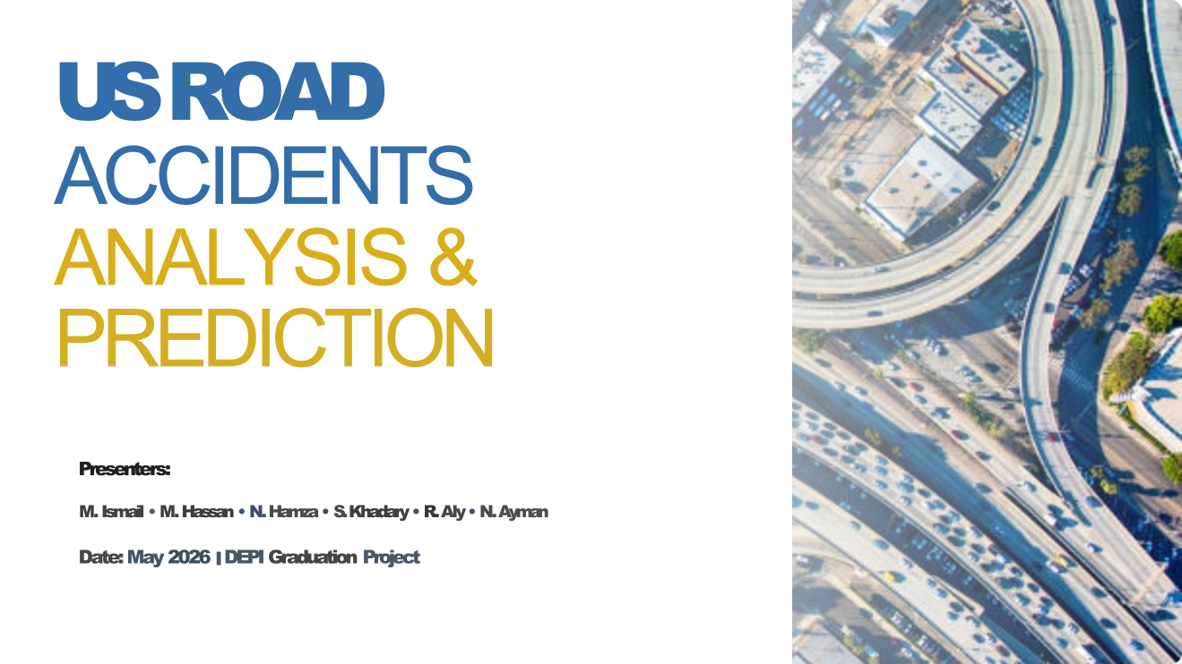
eyouth
DEPI 2026
US Road Accidents
Analysis & Prediction
May 2026 · DEPI Graduation Project

Slide 2



Project Idea
The Problem
Our Solution
Unique Value
US road accidents claim thousands of lives yearly. Authorities lack data-driven tools to predict high-risk events, allocate resources, and prevent severe accidents before they happen.
A full data pipeline (Medallion Architecture) + interactive Power BI dashboards + a Prophet forecast model + CatBoost ML severity predictor — all built on Microsoft Fabric.
Unlike simple dashboards, we combine time-series forecasting, multi-model ML comparison, and real-time severity scoring — enabling proactive, not reactive, road safety decisions.
DEPI Graduation Project 2026

Slide 3
Medallion Architecture
Raw Data
Bronze
Silver
Gold
ML Layer
Kaggle CSV
500K Records
Ingested As-Is
OneLake Storage
Cleaned &
Standardized
Star Schema
1 Fact + 7 Dims
Feature Eng.
& Predictions
Outputs from this Pipeline:
Power BI
Dashboard
CatBoost
Severity Model
Prophet
12-Month Forecast
Star Schema
Data Model
DEPI Graduation Project 2026

Slide 4
End Users & Key Features
Primary User Personas
Key Features
Road Safety Authorities
Risk Hotspot Identification
Identify risk hotspots, allocate resources
CA: 113K · FL: 57K · TX: 37K accidents
Emergency Services
Interactive Power BI Dashboard
Optimize response during high-risk windows
8 pages, filterable by Year/State/Severity
Insurance Companies
ML Severity Prediction
Refine risk assessment using location & weather
CatBoost V4, ROC-AUC 0.746
Urban Planners
12-Month Prophet Forecast
Improve road infrastructure at accident-prone areas
124K predicted, Dec peak at 14,415
Data Scientists
Weather & Time Pattern Analysis
Benchmark ML models for accident prediction
94.75% accidents in normal weather
DEPI Graduation Project 2026

Slide 5
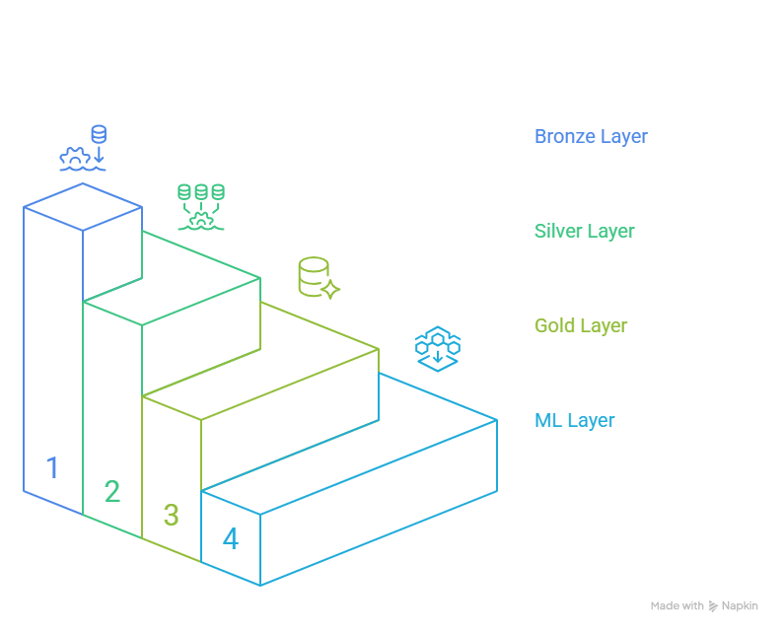
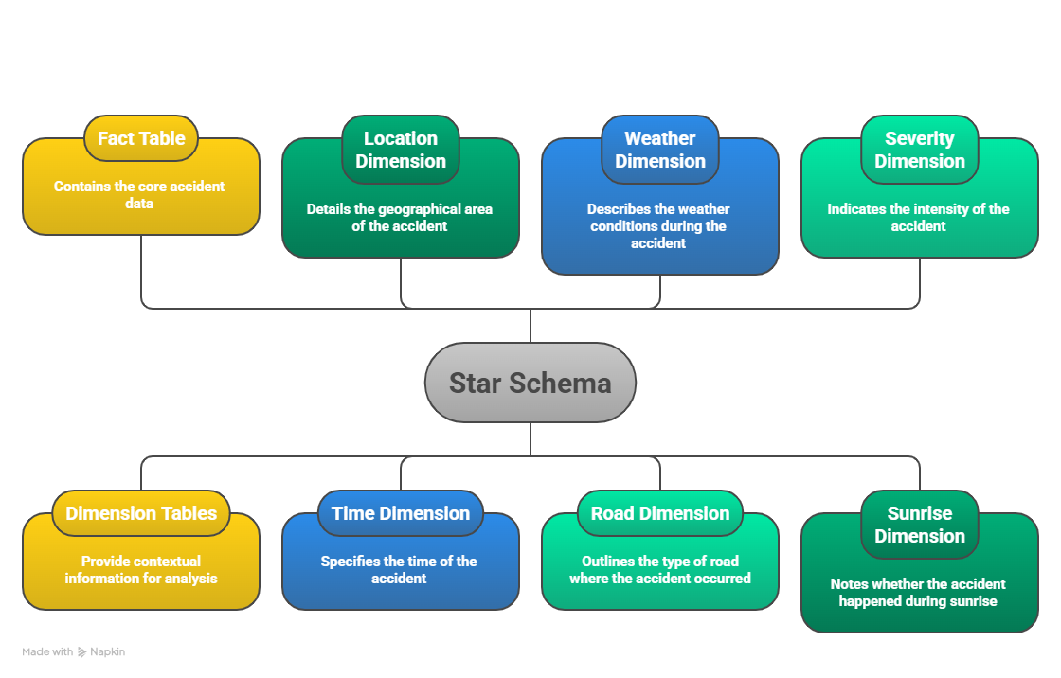
Data Structure & Star Schema
DEPI Graduation Project 2026

Slide 6
Tech Stack & Tools
Cloud & Infrastructure
Programming & Processing
🔷 Microsoft Fabric
☁️ OneLake
🐍 Python
🐼 Pandas
🏠 Lakehouse
🗄️ SQL Endpoint
🔢 NumPy
⚡ SparkSQL
Machine Learning
Visualization & UI/UX
🤖 Scikit-learn
🚀 XGBoost
💡 LightGBM
📊 Power BI
🎨 Figma
🐱 CatBoost
📈 Prophet
📉 Matplotlib
🌊 Seaborn
DEPI Graduation Project 2026

Slide 7
Key Insights: Overview & Time Analysis
500K
19.52%
202K
80%
Total Accidents
High Severity Rate
Rush Hour Accidents
Moderate Impact
⏱ Time Analysis Insights
📊 Overview KPI Insights
Friday is the peak day (89K accidents)
500K accident records from 49 US states
Dec is the highest-risk month (54,589 accidents)
Avg Severity: 2.50 across all accidents
Morning commute (7–9 AM) & evening (3–6 PM) spike
Avg accident duration: 421.9 minutes
202K rush hour accidents — biggest risk window
19.52% classified as High Severity
80K weekend accidents tracked separately
80% Moderate Impact, 17% High, 3% Critical
Accidents grew from 27K (2016) to 114K (2022) peak
Daytime accidents (275K) >> Nighttime in Moderate
DEPI Graduation Project 2026

Slide 8
Key Insights: Weather & Geography
💡 Counterintuitive Finding: 94.75% of accidents occur in NORMAL weather (Fair, Cloudy, Clear) — not storms!
🌤 Weather Insights
📍 Geography Insights
177K accidents in 'Fair' weather — highest category
California: 113K (22.6% of all accidents)
Mostly Cloudy: 65K · Cloudy: 53K · Clear: 52K
Florida: 57K · Texas: 37K (top 3 states)
Extreme weather = only 5% of accidents
Miami leads all cities with ~12,100 accidents
Extreme weather accidents tend to be MORE severe
Houston: 11K · Los Angeles: 10.3K
Low visibility: elevated rain, snow & fog counts
Interstate I-95 North = most accident-prone road
High visibility (428K) dominates total accident volume
Charlotte & Dallas also in top 20 high-accident cities
DEPI Graduation Project 2026

Slide 9
Key Insights: Road Infrastructure
Traffic Signal
Crossing
Junction
74K
56K
37K
Most common road feature in accidents
Second highest volume road feature
Highest Critical/High Impact rate
⚠️ Critical Finding: 70% of all accidents occur where ZERO road features are present — open road segments are the highest-risk zones!
Road Feature Impact on Severity
Actionable Recommendations
Junction = highest Critical Impact rate
Add signals/crossings on open road segments
92.6% of accidents NOT at junctions
Increase enforcement at known junction hotspots
7.4% at junctions → but more severe outcome
Deploy emergency services during Friday rush
Signal accidents: 65,291 Moderate Impact cases
Focus winter safety campaigns on Dec–Jan
DEPI Graduation Project 2026

Slide 10
Machine Learning Results
Model | Task | Accuracy | ROC-AUC | Selected?
CatBoost V4 | Binary | 69.76% | 0.746 ✓ | ✅ YES
LightGBM | Binary | 78.62% | 0.500 ✗ | ❌ No
XGBoost | Binary | 76.85% | 0.500 ✗ | ❌ No
Random Forest | Binary | 68.10% | 0.501 | ❌ No
Logistic Reg. | Binary | 50.06% | 0.499 | ❌ No
LightGBM | Multi-class | 69.83% | — | ❌ No
Why CatBoost?
ROC-AUC 0.746 = genuinely separates High vs Low Risk
LightGBM's 78.62% accuracy is misleading — it just predicts majority class
LightGBM ROC-AUC = 0.50 → random performance
CatBoost threshold tuned to 0.5034 for best precision/recall
363 High Risk + 637 Low Risk out of 1,000 records (36.3% High Risk rate)
Top Predictive Features:
Distance (mi)
4,300
Top features: Distance, Wind Speed, Year, Temperature
Wind Speed
3,900
Year
3,400
Temperature
3,000
DEPI Graduation Project 2026

Slide 11
Prophet Forecast & ML Predictions
124K
14,415
6,731
+40%
Predicted (12 months)
Dec Peak (highest month)
June (lowest month)
Winter vs Summer
ML Predictions (1,000 records)
High Risk (3–4)
363 records (36.3%)
Low Risk (1–2)
637 records (63.7%)
Avg Risk Score
0.44
Decision Threshold
0.5034 (optimized)
Model ROC-AUC
0.746
DEPI Graduation Project 2026

Slide 12





Deliverables & Reports
8-Page Power BI Dashboard
CatBoost ML Model
Interactive report filterable by Year, State, Severity, Weather, Rush Hour
Production severity classifier, ROC-AUC 0.746, threshold 0.5034, 20 features
Prophet Forecast Model
Medallion Data Pipeline
12-month accident volume forecast with 95% confidence intervals
Bronze→Silver→Gold→ML pipeline on Microsoft Fabric with cross-layer validation
Technical Documentation
Figma UI/UX Design
Complete project report (23 pages), architecture diagrams, data dictionary
Full wireframe of dashboard — navy + orange palette, validated before BI build
DEPI Graduation Project 2026

Slide 13


Slide 14



Project Team & Roles
Mohammed Ismail
& Mohamed Hassan
Nesma Hamza
& Shaimaa Khadary
Rawan Aly
& Nourhan Ayman
Data Engineering | Machine Learning
UI/UX Design | BI Development
Technical Documentation | Methodology
🏆 Mentor: Mohamed Alemam
Project Mentor — DEPI Graduation 2026
DEPI Graduation Project 2026

Slide 15
Thank You!
Questions & Feedback Welcome
500K
8
0.746
124K
Records Analyzed
Dashboard Pages
Best ROC-AUC
Accidents Forecast
US Road Accidents Analysis & Prediction · DEPI Graduation Project · May 2026
Team: Mohammed Ismail · Mohamed Hassan · Nesma Hamza · Shaimaa Khadary · Rawan Aly · Nourhan Ayman
Mentor: Mohamed Alemam
eyouth · DEPI 2026

